Slide 1

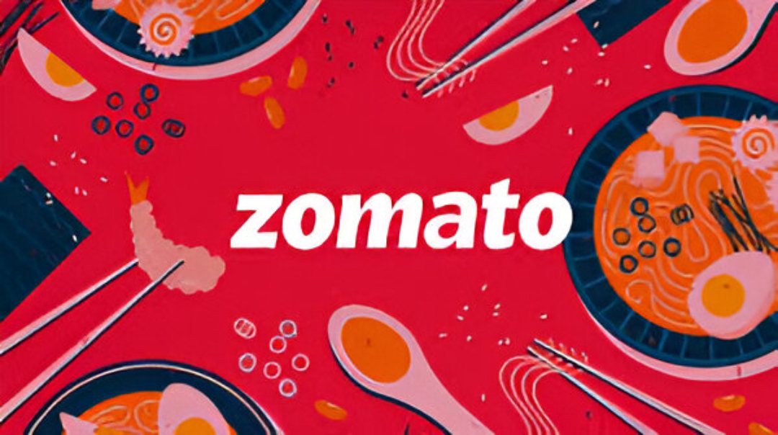
Zomato: Data-Driven Growth & Funding Proposal (2024–2025)
Notes:
Introduction to Zomato’s data-driven business strategy and funding pitch.

Slide 2





The Problem
High delivery costs and low profitability.
Rising Customer Acquisition Cost (CAC).
Declining retention in Tier-1 cities.
Delivery inefficiencies impacting margins.
Notes:
The Indian food delivery space is booming, but operational inefficiencies and high CAC continue to suppress profits.

Slide 3





The Solution
Predictive AI for delivery routing.
Loyalty-based retention (Zomato Gold 2.0).
Data-driven influencer marketing.
Expansion into Tier-2 markets.
Notes:
Our strategy combines AI logistics, loyalty-driven retention, and targeted expansion to improve efficiency and customer lifetime value.

Slide 4
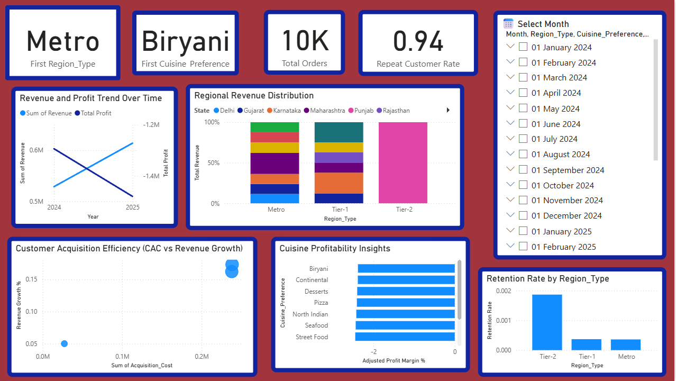
My Role
Role: Business Data Analyst (Internship Project).
Built KPI dashboards using Power BI.
Conducted revenue forecasting & CAC modeling.
Designed funding & expansion recommendations.
Notes:
As the data analyst behind this project, I developed insights that shaped Zomato’s funding and growth plan.

Slide 5
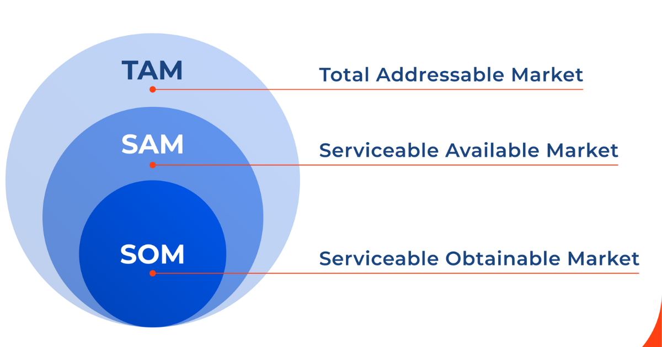
Market Overview
TAM: ₹1.5T by 2026 (+18% CAGR).
SAM: 70% urban + Tier-2 market coverage.
SOM: 55% Zomato share in India.
Tier-2 cities = fastest growth zone.
₹1.5T
70%
55%
Notes:
Zomato leads the urban market and has strong headroom in Tier-2 regions.

Slide 6
Business Model
Revenue Source | % Share
Commissions | 60%
Delivery Fees | 20%
Ads | 10%
Subscriptions | 10%
Notes:
This hybrid model balances one-time and recurring revenue sources.

Slide 7
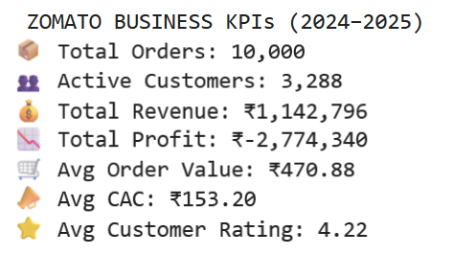
Traction Metrics
Orders: 10,000 | Revenue: ₹1.14M
Active Users: 3,288 | CAC: ₹153
Avg Order Value: ₹470 | Rating: 4.22/5
Notes:
These metrics show consistent engagement and a strong base for scaling operations.

Slide 8
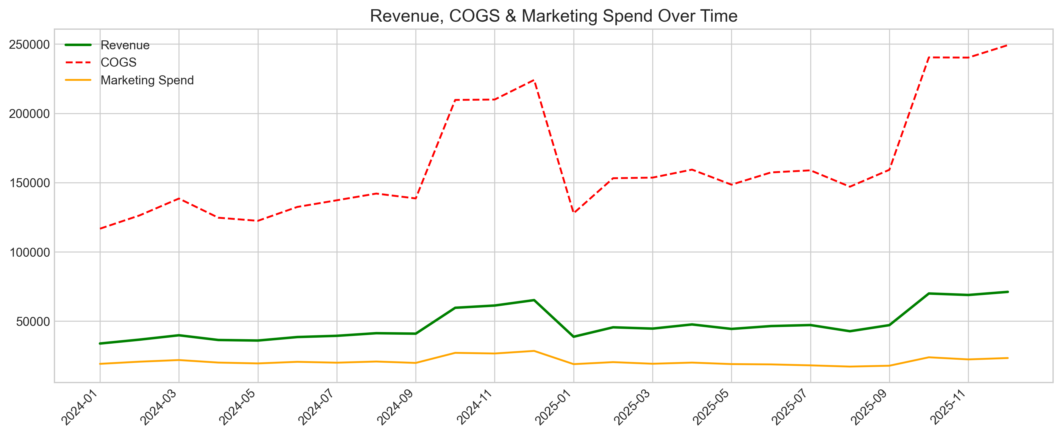
Financial Overview
Revenue grew +16% YoY.
COGS remains high but stable.
Marketing spend optimized by 12%.
Notes:
Our financials show steady growth despite pressure from delivery costs

Slide 9
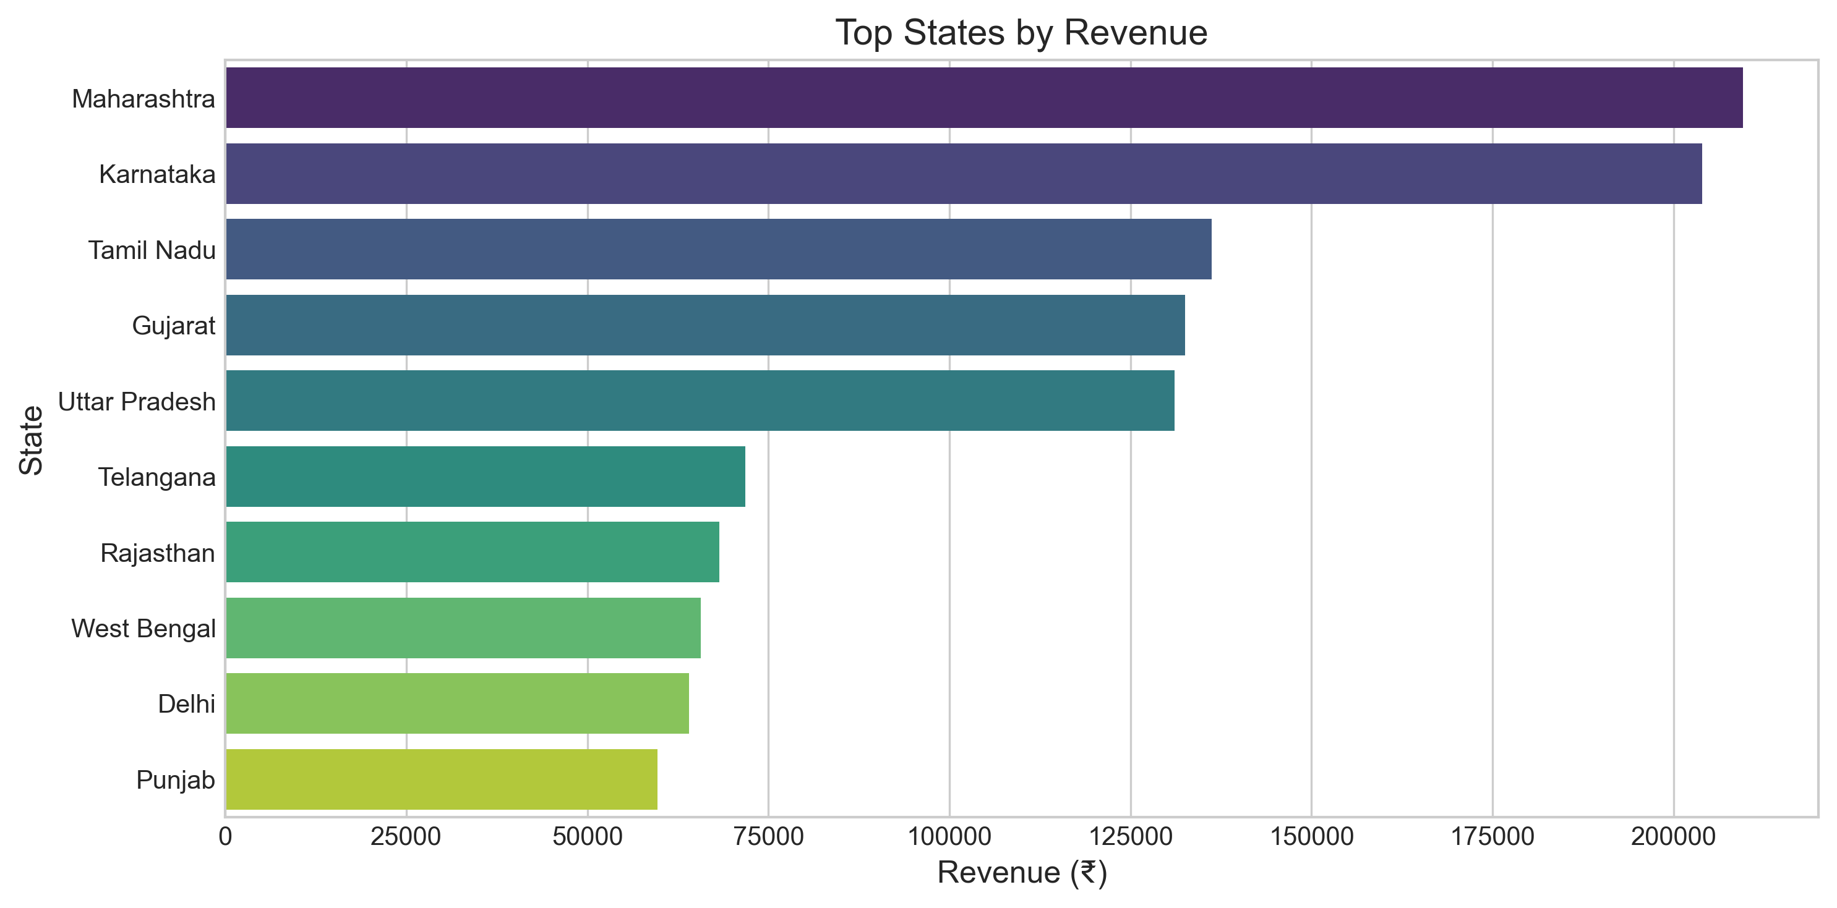
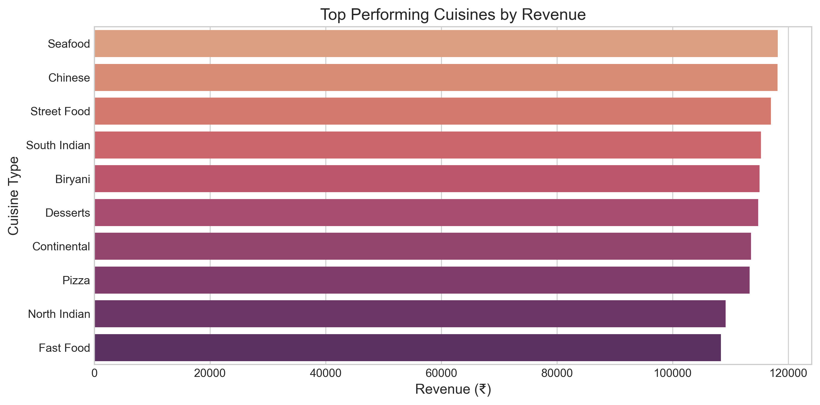
Market Insights
Maharashtra and Karnataka lead in revenue.
Top cuisines: Seafood, Chinese, Street Food.
Notes:
These insights shape our localized marketing and expansion strategy.

Slide 10
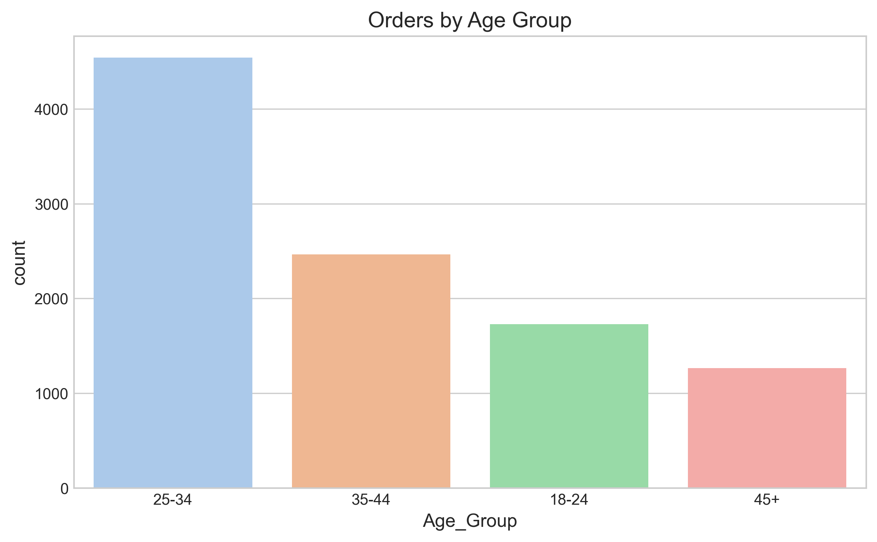
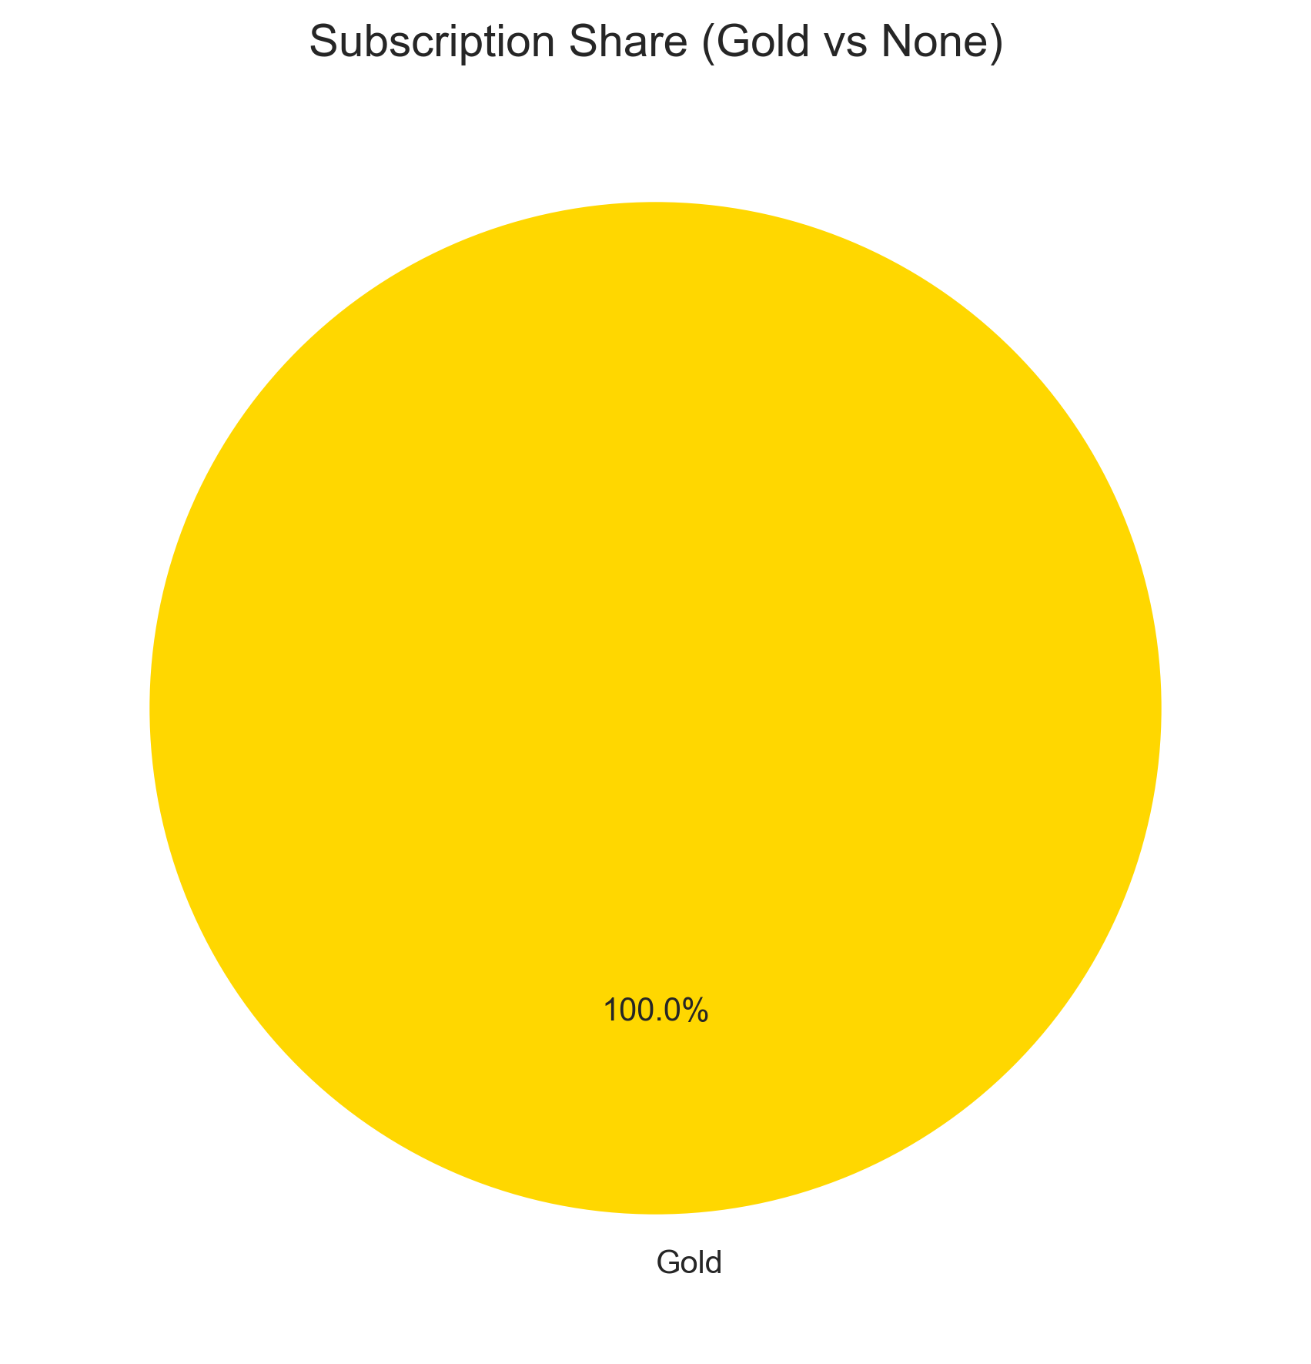
Customer Analytics
25–34-year-olds dominate orders.
Gold users order 2× more frequently.
Notes:
Our most valuable audience segment: professionals aged 25–34 with loyalty memberships.

Slide 11
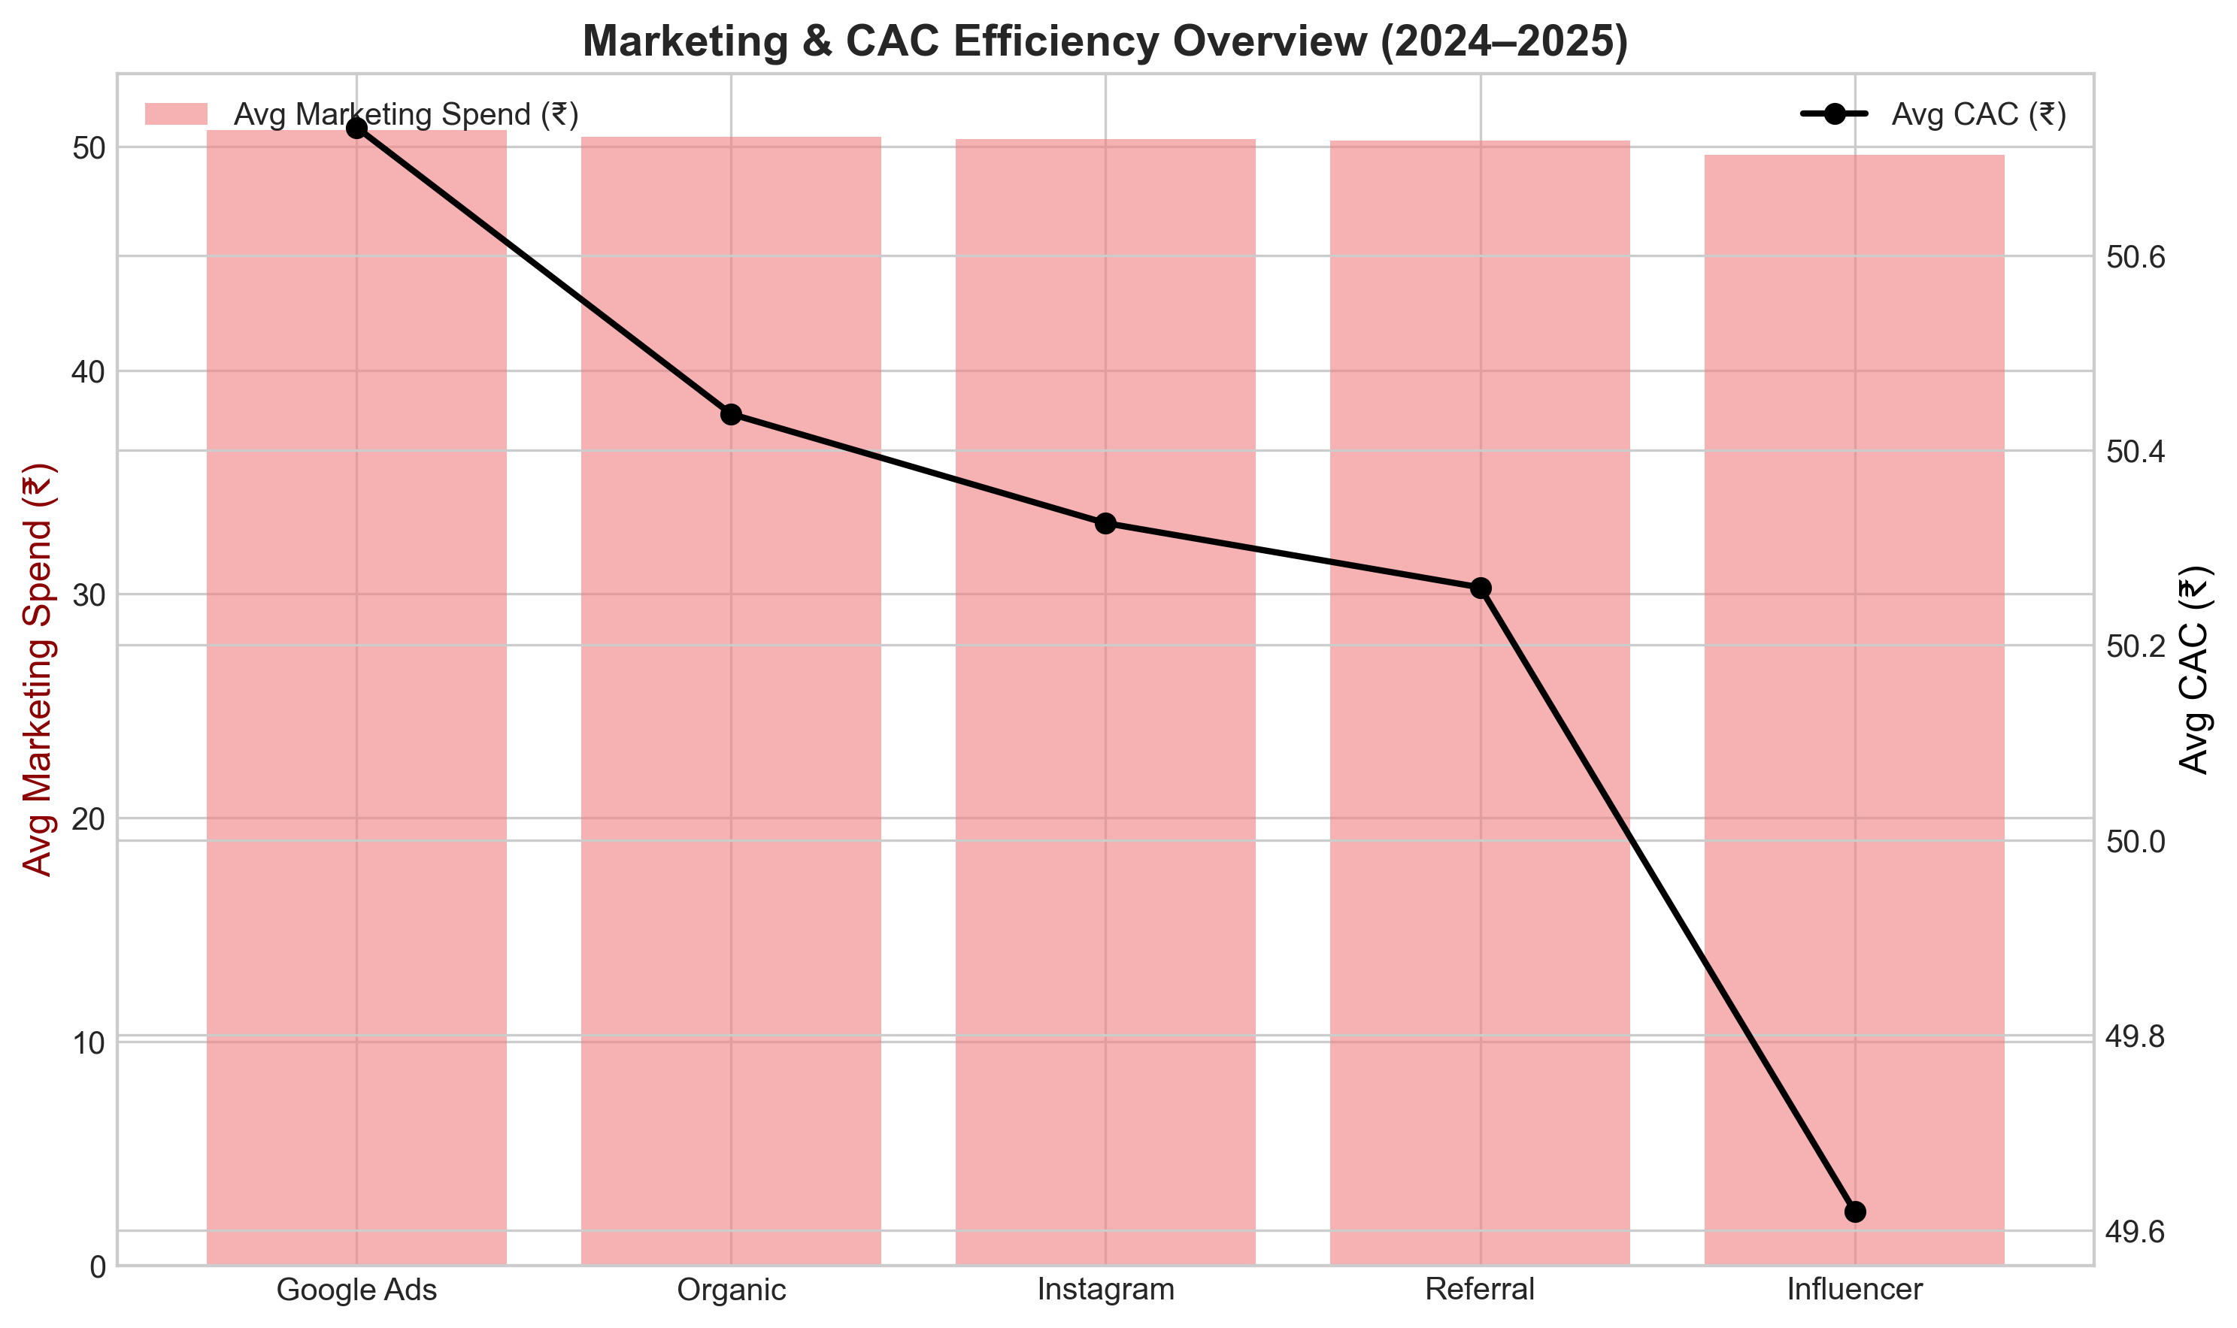
Marketing Efficiency
Influencer and referral campaigns have lowest CAC.
Google Ads is costly, lower ROI.
Notes:
Optimizing ad spend toward influencer-led campaigns could reduce CAC by 15%.

Slide 12
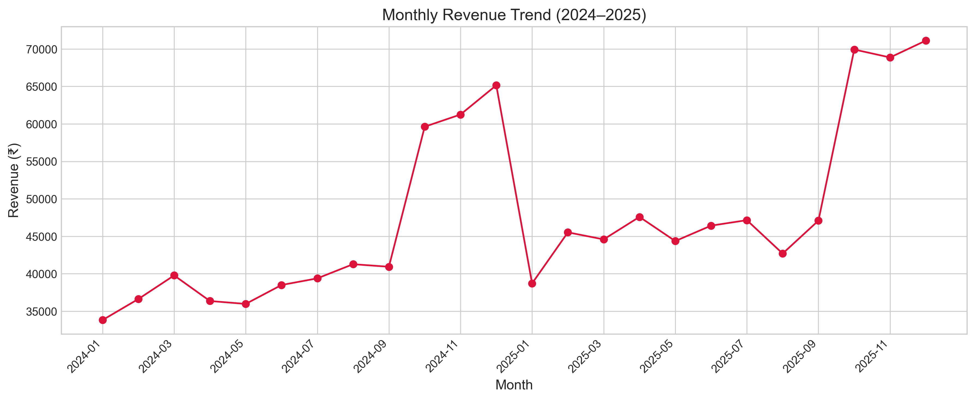
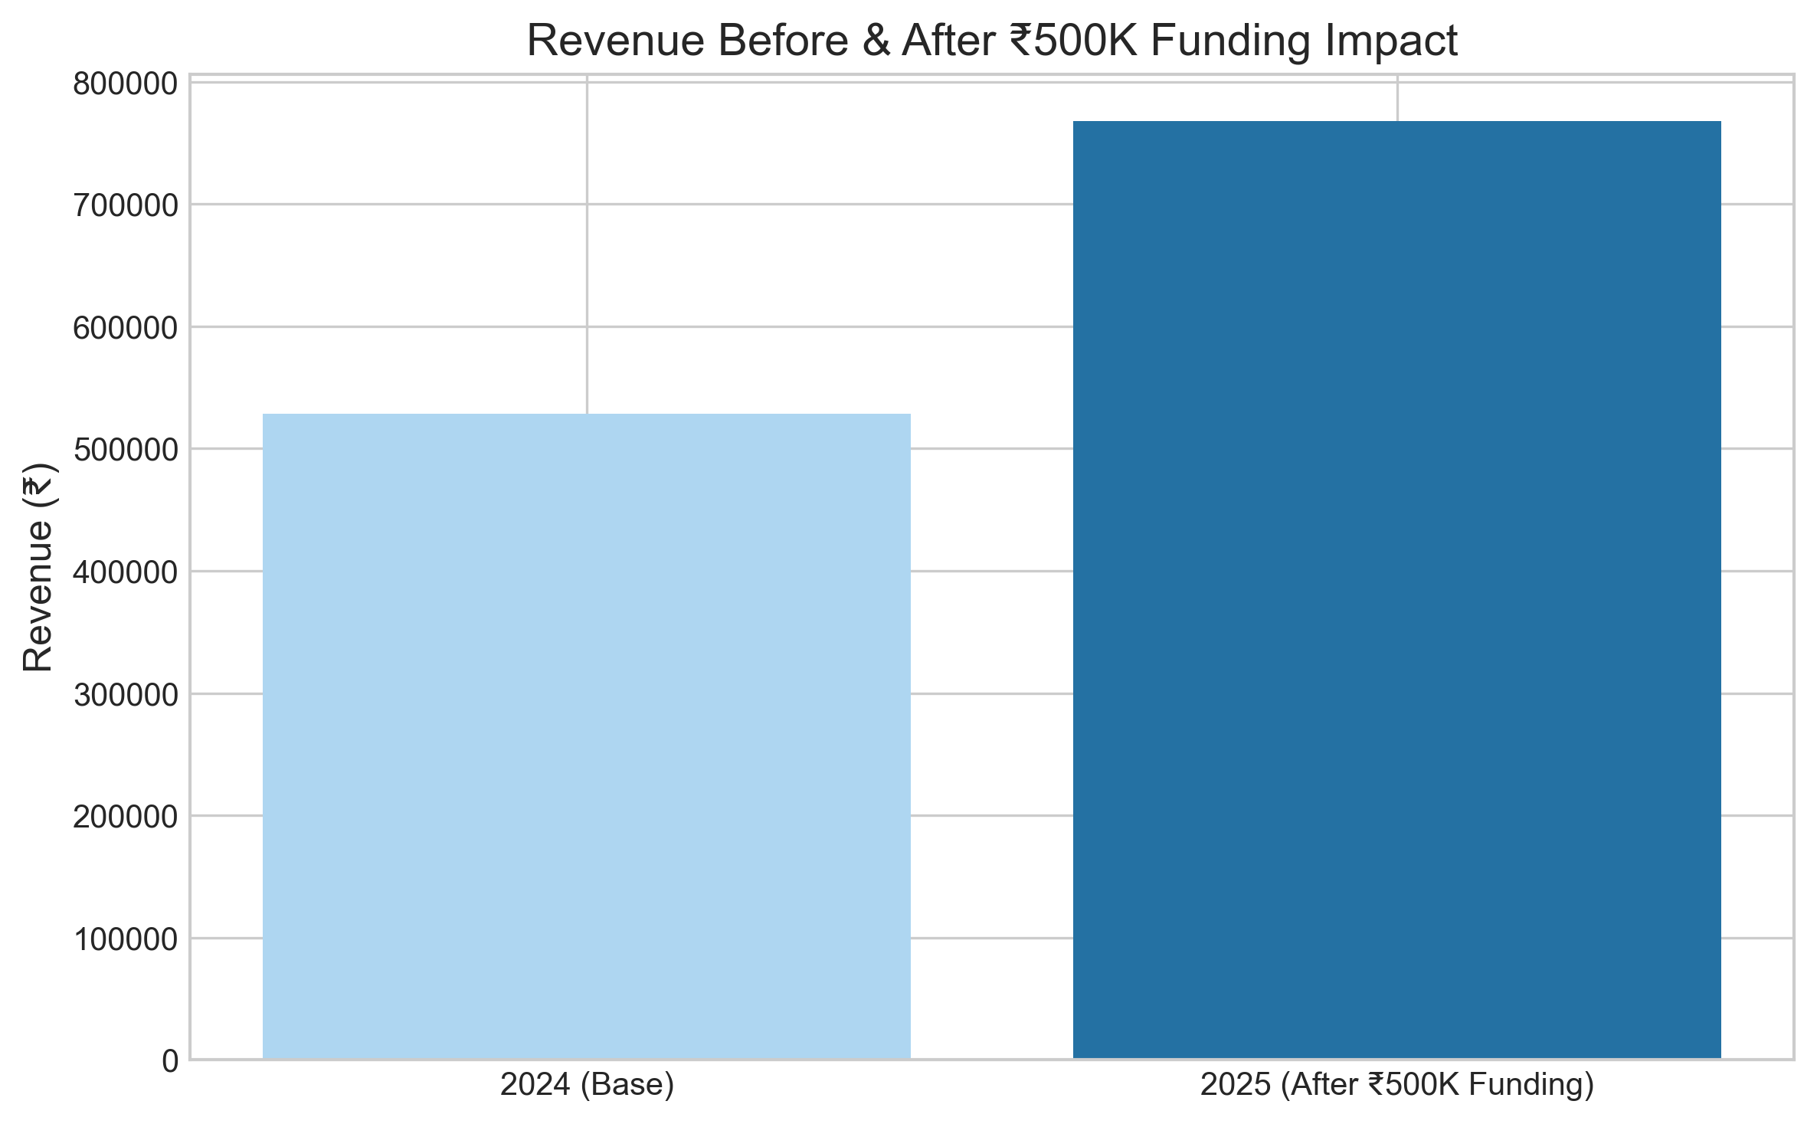
Growth Forecast
+25% revenue growth forecasted post-funding.
CAC drops to ₹130 from ₹153.
Notes:
With ₹500K investment, Zomato can achieve measurable profitability within one year.

Slide 13
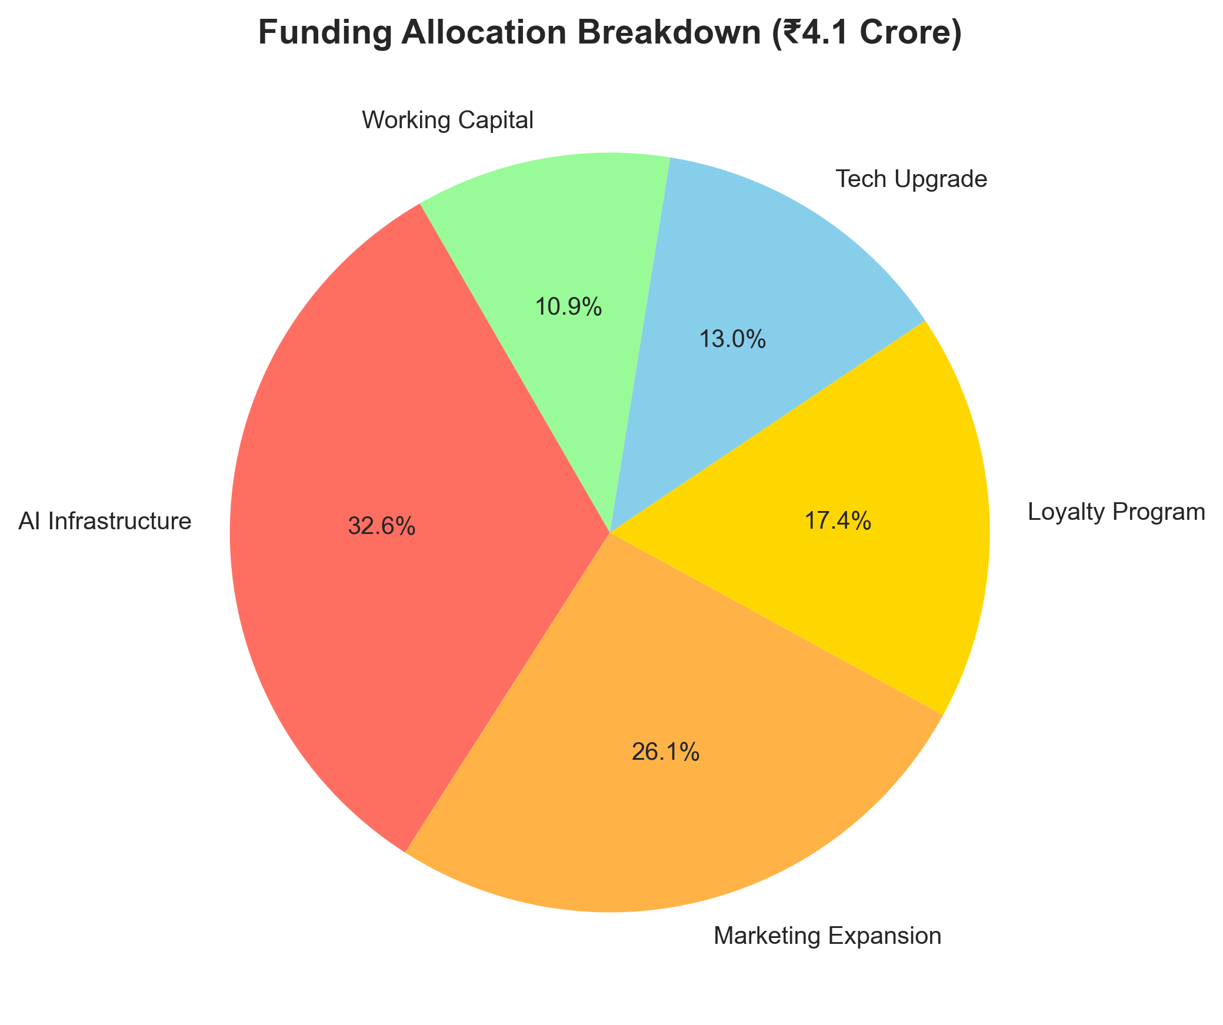
Funding Allocation Plan
AI Infrastructure – 33%
Marketing Expansion – 26%
Loyalty Program – 17%
Tech Upgrade – 13%
Working Capital – 11%
Notes:
AI 33%, Marketing 26%, Loyalty 17%, Tech 13%, Ops 11%.

Slide 14
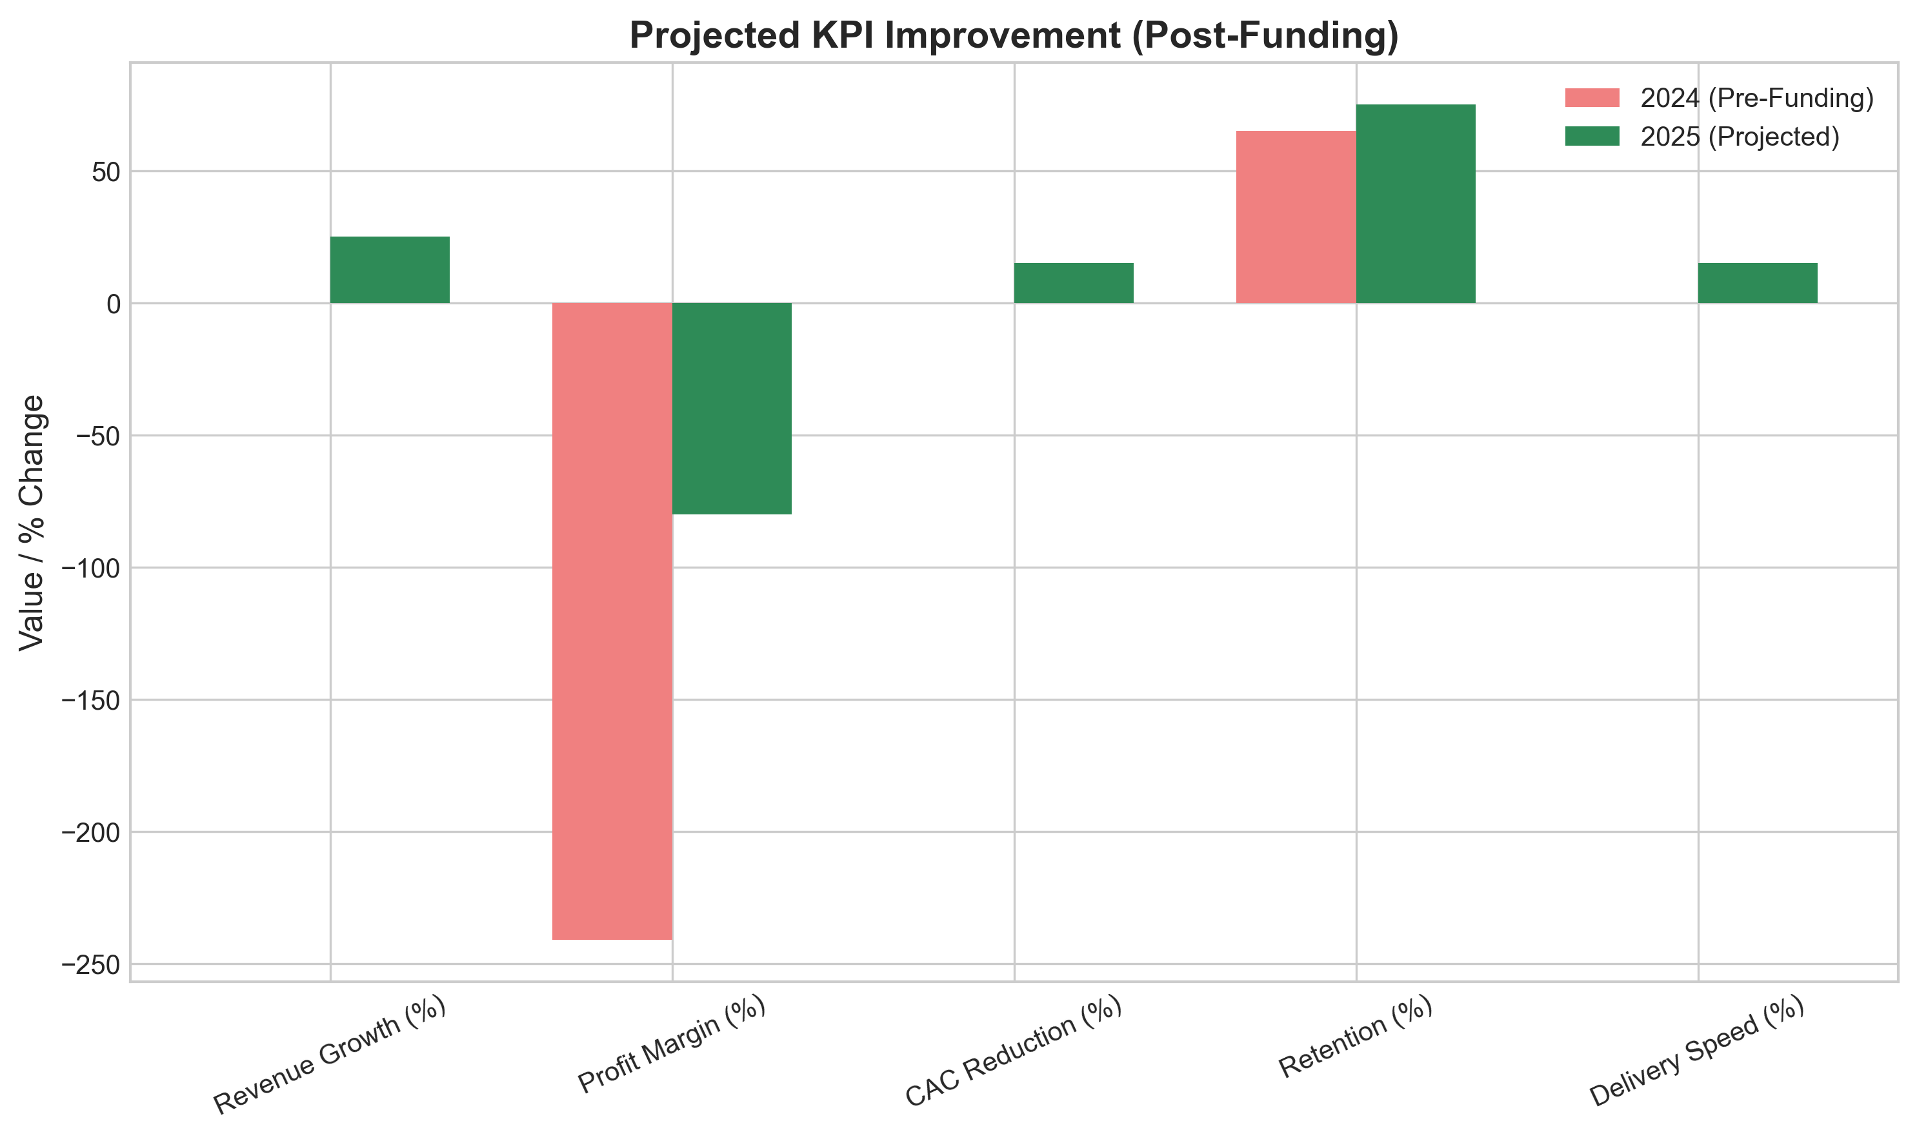
Projected KPI Improvement
Results by 2025:
+25% Revenue
–15% CAC
+10% Retention
+15% Faster Delivery
Notes:
This funding unlocks efficiency and retention gains across the platform.

Slide 15
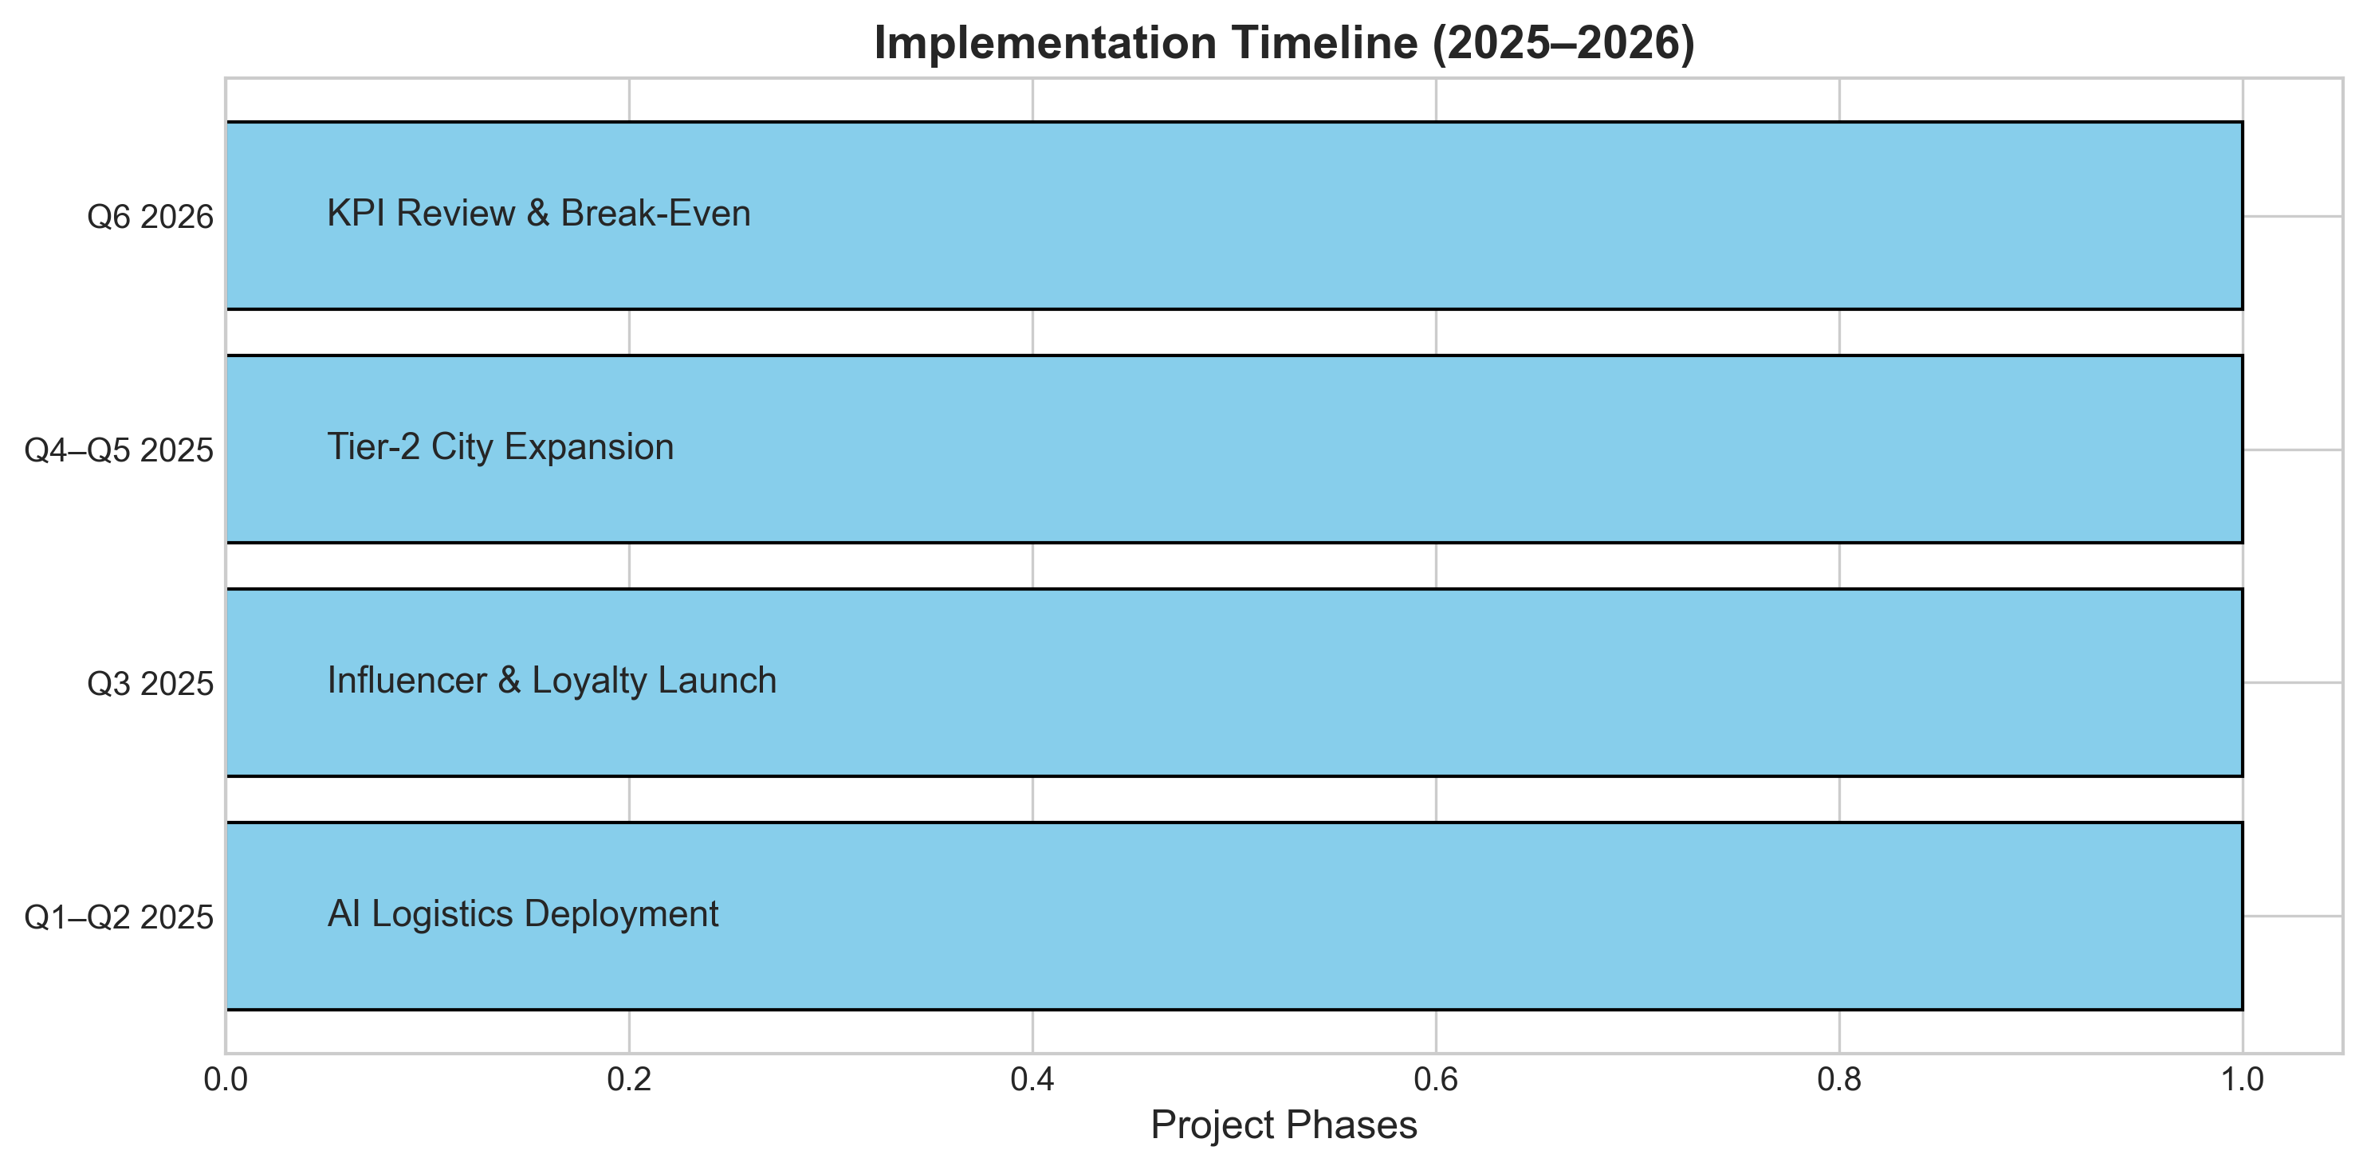
Implementation Roadmap
Milestones: ✅
Q1–Q2: AI Logistics Deployment
Q3: Loyalty + Influencer Launch
Q4–Q5: Tier-2 Expansion
Q6: Breakeven Review
Notes:
This structured rollout ensures measurable progress every quarter.

Slide 16
Funding Ask
Zomato seeks ₹4.1 Crore (~$500K) for:
AI Logistics (33%)
Marketing (26%)
Loyalty (17%)
Tech (13%)
Operations (11%)
Notes:
The requested ₹4.1 Cr will enable sustainable growth and prepare for Series A investment.

Slide 17
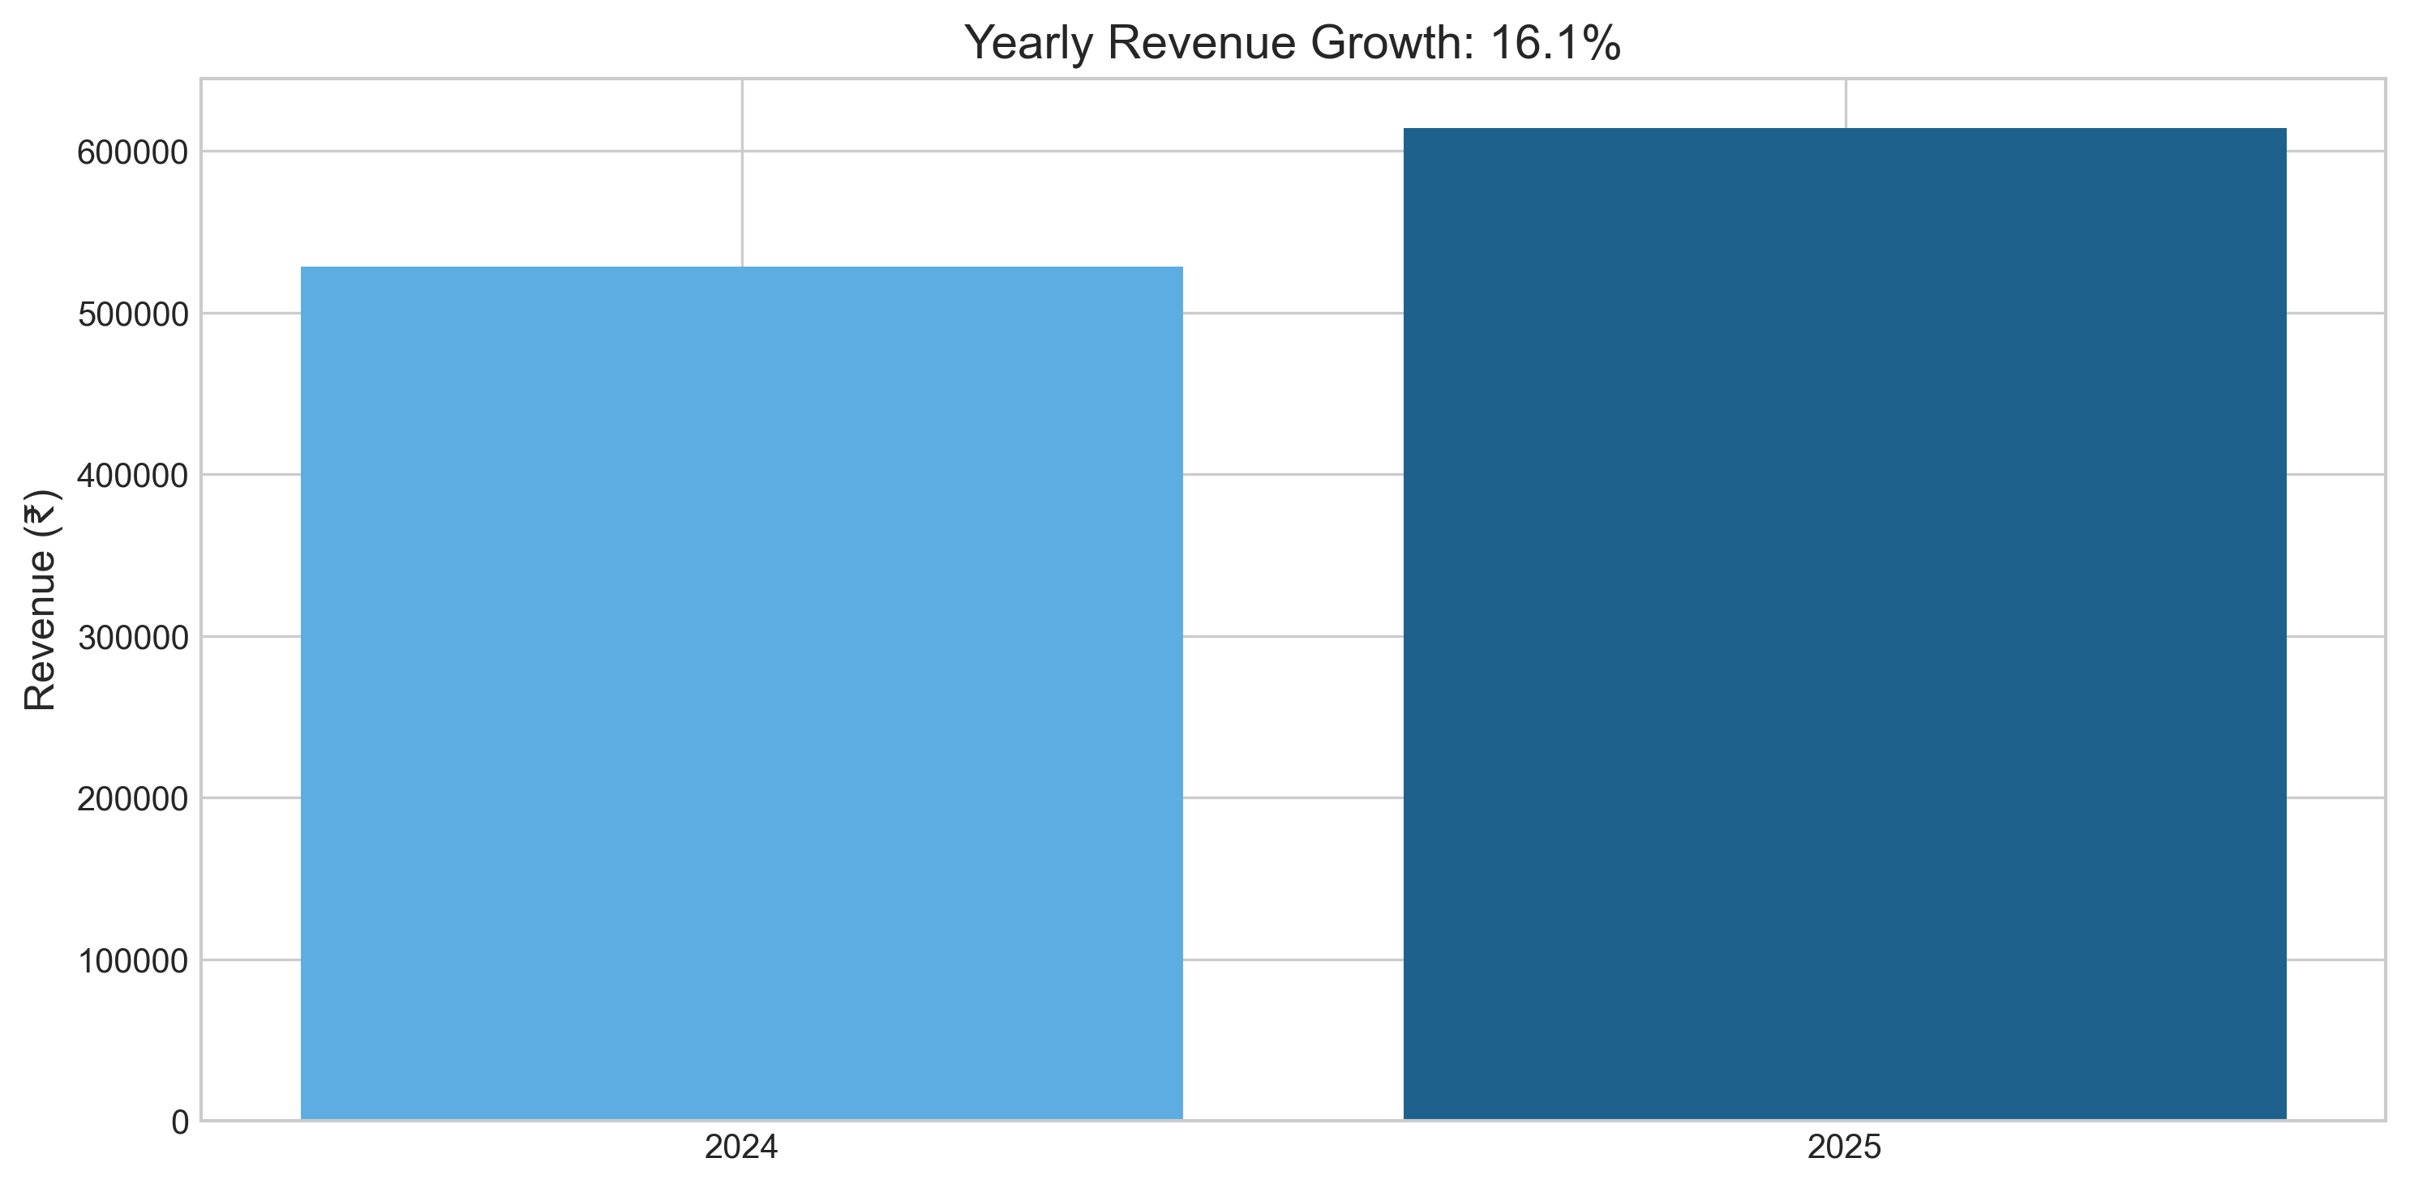
Financial Projections
Forecast:
Revenue: ₹1.42M (+25%)
CAC: ₹130 (–15%)
Retention: +10%
Notes:
This funding translates directly into measurable performance improvements.

Slide 18
Risks & Mitigation
Competition | High Cost | Churn | Saturation
Mitigation: AI, Tier-2 focus, loyalty, influencer campaigns
Risk | Mitigation
Competition (Swiggy/Blinkit) | Tier-2 focus
High Delivery Cost | AI route optimization
Retention Drop | Gold 2.0 & loyalty rewards
Marketing Fatigue | Influencer diversification
Notes:
Identified risks are actively mitigated with targeted operational and marketing strategies.

Slide 19
Q&A
Delivering Happiness, Data at a Time
Notes:
Thank you for your attention — I’m happy to take your questions.

Slide 20
Appendix
Dataset: Simulated Zomato Customer & Order Data (2024–2025) – Created for analytical demonstration.
Secondary Data: Statista (2024–2025) – India Online Food Delivery Market Size & Growth.
Industry Insights: Economic Times & McKinsey Digital Reports (2023–2025) – AI & Logistics Trends.
Analytical Tools: Python (Pandas, Matplotlib), Microsoft Power BI, and Excel for visualization and forecasting.
Dashboard Visuals: All KPIs, trends, and projections derived from Zomato dataset and scenario modeling (₹500K funding impact).

